Slide 1
Debugging, Files and SDLC
Warren Toomey,
Jeff Nugent
Notes:
<number>

Slide 2
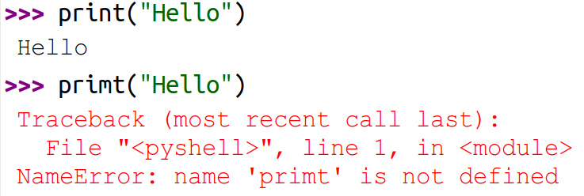
Programming Errors
Syntax error
Interpreter can’t understand your code, dependent library not found
Why won’t this code run?
Insert competency code
Notes:
Text
<number>

Slide 3
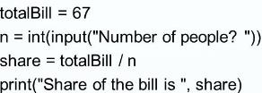

Programming Errors
Run-time error
dividing by zero, a file is missing,
internet isn’t working – stop now
Python found problem at run-time (e.g. input: 0 people)
Insert competency code
Notes:
Screenshot, text only
<number>

Slide 4
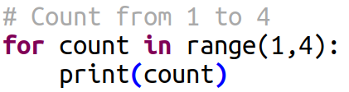

Programming Errors
Logical error
Everything works but result is unexpected (e.g. 1 + 2 = 99)
e.g. Count from 1-4
Why is this code wrong? Why didn’t Python warn us?
Insert competency code
Notes:
Thonny screenshot, app is open source
<number>

Slide 5
Debugging Tips
Class question: what works for you when resolving errors?
Use print() statements to identify where you are and variable values
Copy parts of your code segment into a new program
Simplify and check each part – is this part doing what you want?
Really stuck? Find a related, working example online – compare with your code.
Sum=a+b+c isn’t working? Try: print(“a=” + str(a)) to see what each value is.
Insert competency code
Notes:
<number>

Slide 6
Debugging Tips
Google! Put “” around your error messages for specific phrase searches
e.g. “can’t assign to literal” (make sure to include the “” quotes)
Look for answers or ask questions on these sites:
www.stackoverflow.com
www.programiz.com/python-programming/examples
wiki.python.org/moin/SimplePrograms
Insert competency code
Notes:
<number>

Slide 7
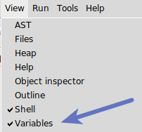
Debugging With Thonny
Use the debug icon or Ctrl-F5 to start debugging
Use the Step Over icon or F6 to run the next line
Use the Step Into icon or F7 to evaluate expressions and go into functions, and to see intermediate calculations
Show your variables while debugging to help with logical errors
Watch this video:
Debugging with Thonny
Insert competency code
Notes:
Thonny screenshot
<number>

Slide 8
Integrated Development Environments
Common features
Syntax highlighting
Click-to-run integration with Python interpreter
Run code one line at a time
Real-time inspection/modification of variables
Lookup of functions/parameters
Online documentation of functions
Visual IDEs
Programming by drawing windows, placing buttons, making forms
Examples: Microsoft Access, Lego Mindstorms
Insert competency code
Notes:
<number>

Slide 9
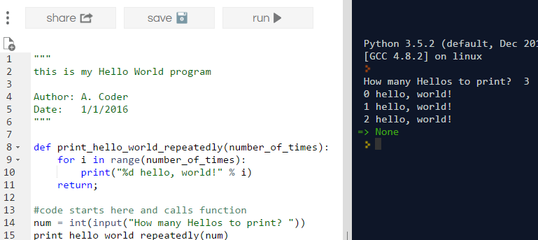
Simple IDE – repl.it
Basic functionality – integrated Python interpreter, syntax colouring, run/stop, output window
Insert competency code
Notes:
Repl.it website screenshot. See comment in slides from topic 1. No idea of license, terms on website unclear.
<number>

Slide 10
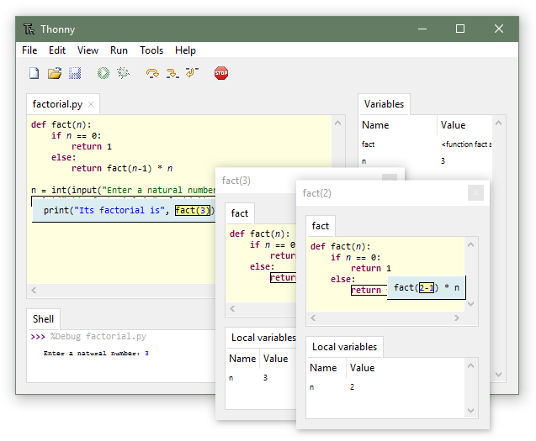
Thonny
Basic functionality – integrated Python interpreter, syntax colouring, run/stop, output window
Insert competency code
Notes:
Thonny screenshot, from website.
<number>

Slide 11
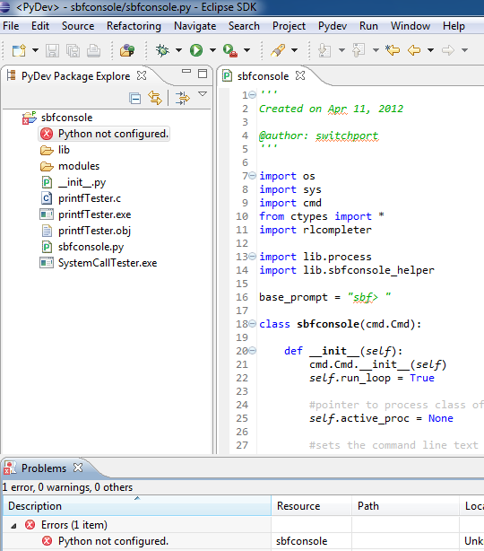
PyCharm and Eclipse (PyDev plugin)
Computer privileges to install software
Download, install interpreter separately
Configure IDE to find interpreter and other libraries/modules
Significant initial learning curve
Insert competency code
Notes:
Screenshot of Eclipse application. Under an open source license: https://www.eclipse.org/legal/epl-v10.html
<number>

Slide 12
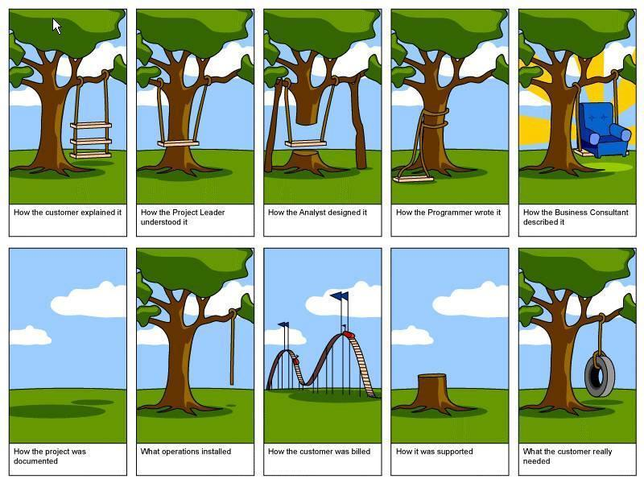
Software Development
Insert competency code
Notes:
Again, been around for ages. No idea of attribution. Search images “how the customer explained it swing”. Would love to keep it if possible.
<number>

Slide 13
Software Development Lifecycle (SDLC)
You designed, tested, distributed program – you’re done!
Wrong!
Who teaches the users how to use your program?
Who fixes the bugs? Creates the documentation? Adds a new feature?
Who verifies it isn’t affected by the newest security flaw?
Majority of software development effort has nothing to do with initial coding
Ongoing support often takes 50-80% of budget (by design or accident)
Insert competency code
Notes:
<number>

Slide 14
Software Development Lifecycle (SDLC)
If we improve the development process: this could reduce bugs, ensure and improve efficiency
Software Development Life Cycle
http://www.tutorialspoint.com/sdlc/sdlc_quick_guide.htm
Insert competency code
Notes:
<number>

Slide 15
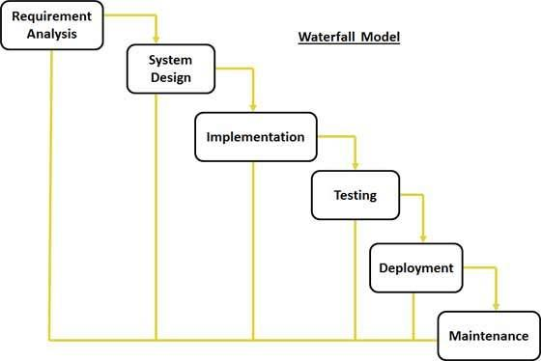
SDLC Models
Many models: Waterfall, Iterative, Spiral, Big Bang, Agile
Insert competency code
Notes:
Search images “waterfall model diagram”. Dozens of them. Can we get it redrawn?
<number>

Slide 16
Waterfall SDLC Model
Traditional approach
Requirement Gathering and analysis - documented in a specification document
System Design – requirement spec doc analysed and design made
Implementation - units/modules created and partly tested
Integration and Testing – fully connect modules/services and test
Deployment of system – system turned on or run in parallel
Maintenance – bug fixes, security patches, feature upgrades, training
Insert competency code
Notes:
<number>

Slide 17
Waterfall SDLC Model
Pros: Sequential, orderly, predictable – recipe approach.
Cons: Fantasy
Client changes requirements during testing, the target audience changes, the market changes, time pressure, etc.
Most popular models now? Waterfall / Agile / Rapid Prototyping very common
Insert competency code
Notes:
<number>

Slide 18
In-class Exercise (30 minutes)
In small groups, research/present one SDLC model
Iterative
Spiral
Prototyping
Agile / “Extreme” Programming
Others?
Teach me!
Brief description of the SDLC model
Define key terms (prototype, scrum, sprint)
Usage: is it ideal for critical / life-or-death systems? for rapid development?
Advantages / Disadvantages
Insert competency code
Notes:
<number>

